Slide 1
Professional Selling Events
Advisor Skills Series
September 29, 2021
Notes:
Welcome to this work workshop on Successful Written Events

Slide 2
PSE
Overview
What are PSE events?
How to start your students.
Details
Presentation tips
FLC option
Recorded only
September 29, 2021
Notes:
Welcome to this work workshop on Successful Written Events

Slide 3
PSE events
FLC – mock
Area qualify/allocations
SCDC
ICDC
Presentation + test + 1 participant only

Slide 4
What are Professional Selling Events? *student delivers a sales presentation or consultation
Financial Consulting
Hospitality & Tourism
Professional Selling
Buying a home &
qualifying for a
mortgage
Virtual 5K race -
target core racers &
expand market
Health & safety experience for customers & employees
Exam + oral presentation
100 pts
2 x 100 pts = 200 pts

Slide 5
Getting Started
Select on actual company
Select real product or service to be presented
Use the steps of the selling process
Meet the needs of the customer (prospect)
Read & decide on scenario

Slide 6
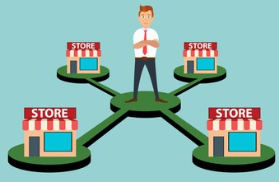
Finance Marketing
Financial Consultant Sales Representative
Mortgage loan officer or broker
Work with local bank or credit union
Provide health & safety auditing
Consulting solutions
Who is your client?
Who is your client?
Facts:
$65,000 year annual income
$300 month car payment
Facts:
Owns a chain of convenience stores
Explain 4c’s
Capacity
Credit
Cash
Collateral
Meet to verify
Compliance with guidelines
Industry best practices
Product & services company can offer
*for customers & employees

Slide 7
Hospitality & Tourism Professional Selling HTPS
Sales Representative
Virtual running/race events company
Who is your client?
*Director of tourism
Facts
City with population of 150,000
Wants to show off what city has to offer which is
many nature & outdoor activities
perfect for long weekend getaways
Virtual 5K run to attract core market & expand beyond
Goal: present ideas to showcase city, leverage your company’s running event products & services, and bring tourism to the city

Slide 8
“Goal”
Student presentation
BEST EVER! GOOD START TO THE TOP!
Notes:
What is your goal?
To submit the very best event you can.

Slide 9
Presentation
Participant
Salesperson
or
Consultant
Judge
Potential Buyer?
Client?
What visuals will you use?
Be sure to adhere to guidelines
Flyers / brochures / business card
Technology (Laptop / tablet / ipad
Forms / documents
Presentation boards
Other visuals that work with presentation
Notes:
Look at the entire project.
10 page events are not 5 pages of text and that’s it.
20 page events are not 11 pages longs and 9 pages of an appendix.
Think about getting pre-punched paper, so it fits nicely in your folio if it must be mailed in or submitted in-person.
Best option for paper is white, but color is fine. Not necessary to use hard card stock or glossy paper.
Should you use a border. It does make for a more pulled together professional look, but keep the border plain (thin line) and one color that matches the color scheme of the document. Nothing ornate or overwhelming.
Font size—always avoid large fonts that just take up space. Traditional Calibri, Arial or Times Roman works best.

Slide 10
What makes a presentation successful?
Great opening / close
Energy – enthusiasm
Realistic Visuals
Make the ask!
The Judge!
Notes:
Keep in mind the perspective of the judge who is evaluating the event. He or she is perhaps judging anywhere from 10-15 events, so turning in a quality event that follows the guidelines, is visually appealing and interesting to read is extremely important.

Slide 11
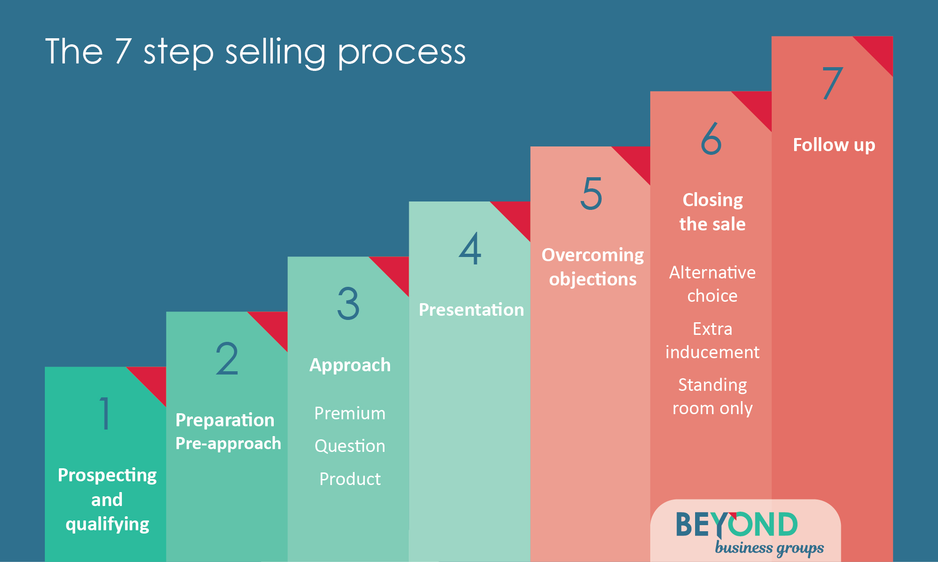
A
D
I
A
Action
Desire
Interest
Attention

Slide 12
DECA Guide
P. 101

Slide 13
Presentation Ready? “is it really ready to be presented?”
Used all the
Steps of Selling Process
Practice, Practice
Ready
Understand the Presentation evaluation form (rubric)
What visuals are used?
Notes:
Are you done? Not yet. Before you submit your project follow these steps.
Look at the event with a critical eye. Check the format is correct and the project follows the sequence noted in the guidelines using the exact section titles. Proofread, proofread and check again for grammatical errors. Run a final quality check. Then are you ready to submit? No, not until you penalty point your event.

Slide 14
HTPS @ FLC
Helps to prep for Area
Event Scenario Simplified version
Sales rep meets director of tourism
5K virtual run
Target: core base of runners but expand to at least one additional participant base
Showcase running event products & services (at least 2)
Identify &
showcase city
Core Children
*will use modified version of Evaluation Form P.101 DECA Guide

Slide 15
linda@wadeca.org
Notes:
Any questions? Visit the chat room if it is available or email linda@wadeca.org.
Thank you.

