Slide 2
ClosE reading
Jigsaw article activity (based on 5 articles/25 students in class)

Slide 3
Get into 5 groups of 5

Slide 4
Once in groups…
Assign each person a letter a-e (each person getting different letter)

Slide 5
Step one
On your own, read the article your numbered group was given.
As you read, annotate using the following:
* this is important
V vocabulary I am unfamiliar with
In margins, connect with the article (engage with the text)

Slide 6
Step two
In 1st Read Quick Write box on your worksheet, write the answers to the below questions (still on your own):
What is the main idea of the article?
What are the author’s basic concepts? (Directly from the reading; evidence.)

Slide 7
Step three
In Groups 1-5 (like articles), take turns reading your Quick Writes out loud.
Share what you learned with each other with the purpose of gathering important information that you may have missed from the reading.
Become an expert on this article so you can teach others!

Slide 8
Step four
From your sharing of the Quick Write, in the Oral Quick Write box:
What assumptions is the author making? (Inferences from reading)
What do you think the author wants you to gain from the article? (Take away; application)

Slide 9
Step five
Move into your A/B/C/D/E groups (different articles)
You have 60 seconds each to teach the main ideas of your article with your new group members.

Slide 10
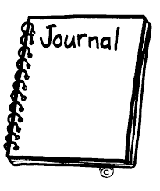
Step six
On your worksheet, develop a 2-3 paragraph journal entry on the topic indicated.

